Slide 1
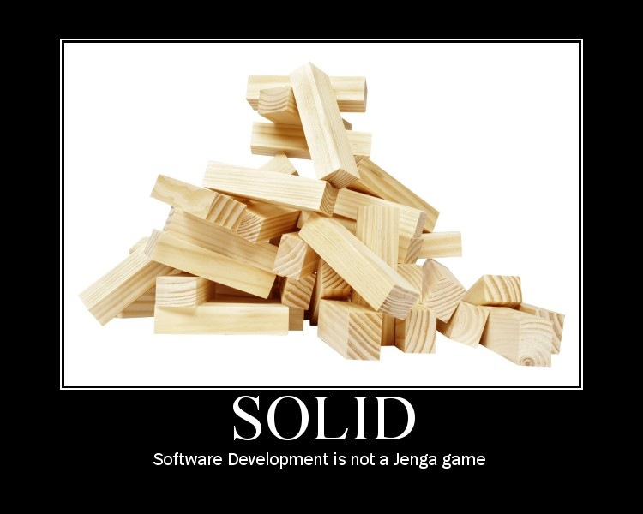

Slide 2
Object Oriented Principles
They’re Not Just For Academics And Ivory Tower Architects
Notes:
OO is about the primary use of code / logic, first. Code re-use is low on the totem pole.
If you can’t correctly use your objects in the app they were built for, for the initial reason they were built, you have zero chance of ever re-using them successfully

Slide 3
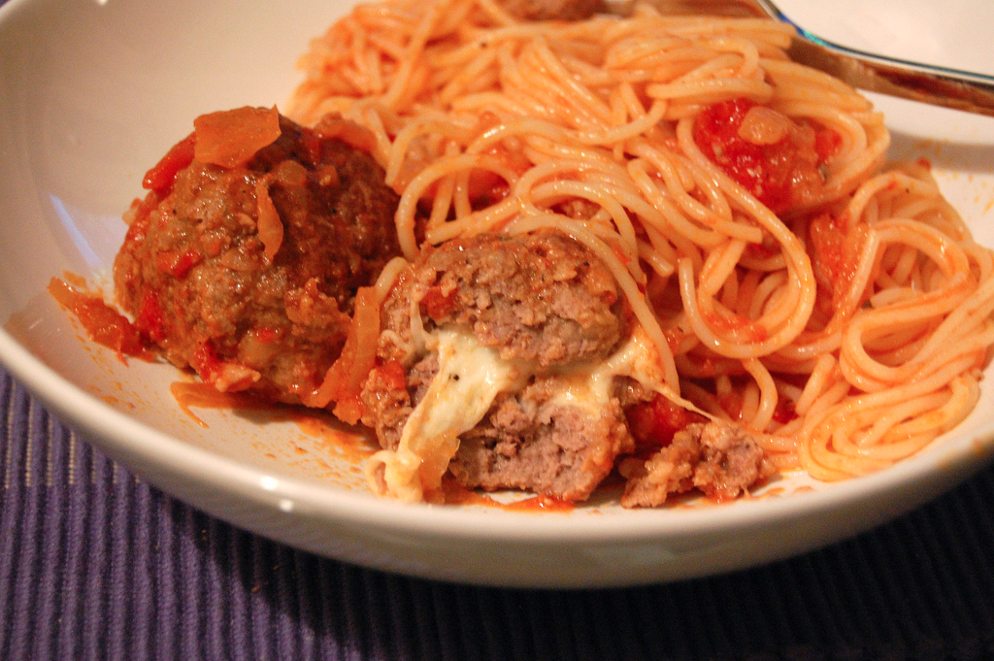
Coupling
Coupling:
“The degree to which each program module relies on each one of the other modules” – Wikipedia
Photo Source: http://www.flickr.com/photos/su-lin/2268003292/sizes/l/in/photostream/
Notes:
The spaghetti mess… if I just want the gooey goodness of the meatball, do I have to bring along the noodles that are attached to other meatballs?

Slide 4
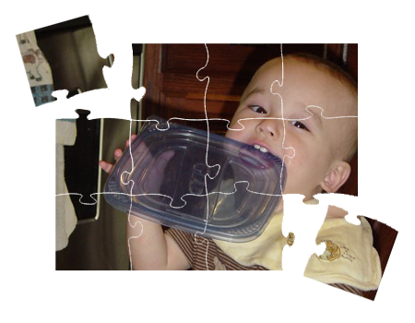
Cohesion
Cohesion:
“A measure of how strongly-related and focused the various responsibilities of a software module are” - Wikipedia
Notes:
the whole is greater than the sum of the parts.
A 10,000 line “god” class (all powerful, all knowing) cannot be cohesive, by definition

Slide 5

encapsulation
Encapsulation:
“The hiding of design decisions in a computer program that are most likely to change” - Wikipedia
Photo Source: http://www.flickr.com/photos/adamcrowe/4299996507/sizes/o/in/photostream/
Notes:
Information hiding, not just data hiding.
A black box… but with an API to get something in and out.

Slide 6
S.O.L.I.D. Software Development
Achieving Object Oriented Principles, One Step At A Time
Notes:
SOLID helps us get to the lofty goals of the OO principles

Slide 7
SOLID Principles
SRP: Single Responsibility Principle
OCP: Open Closed Principle
LSP: Liskov Substitution Principle
ISP: Interface Segregation Principle
DIP: Dependency Inversion Principle

Slide 8
SRP: Single Responsibility Principle
There can be only one
“If a class has more then one responsibility, then the responsibilities become coupled. Changes to one responsibility may impair or inhibit the class’ ability to meet the others. This kind of coupling leads to fragile designs that break in unexpected ways when changed.”
- Robert C. Martin
Notes:
Its one reason to _change_ not one reason to exist.
What does that mean? Why is that perspective important?

Slide 9
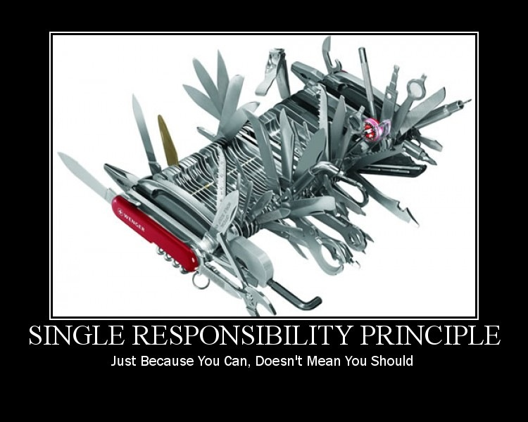

Slide 10
Single Responsibility
Example App: Read A Flat File And Send An Email
Email Sending App
File
Notes:
Basic requirements of the app: read a file, send an email.
Show the super simple demo app code
Ask how many responsibilities are found in there?

Slide 11
Single Responsibility
Email Sending App
Email Sender
Flat File
XML File
Notes:
New requirement: flat file or xml file
Factor email sender out, to introduce single responsibility
Show code

Slide 12
Single Responsibility
Email Sender
Format Reader
Flat File
XML File
Notes:
Factor format reader out to introduce SRP, because multiple formats are needed.
Show code

Slide 13
OCP: Open Closed Principle
There is no spoon
Modules that conform to open-closed have two primary attributes:
They are “Open For Extension”
They are “Closed for Modification”
- Robert C. Martin
Notes:
Don’t “bend the spoon” (change our code), but bend ourselves…
change the behavior of the code without changing the code

Slide 14
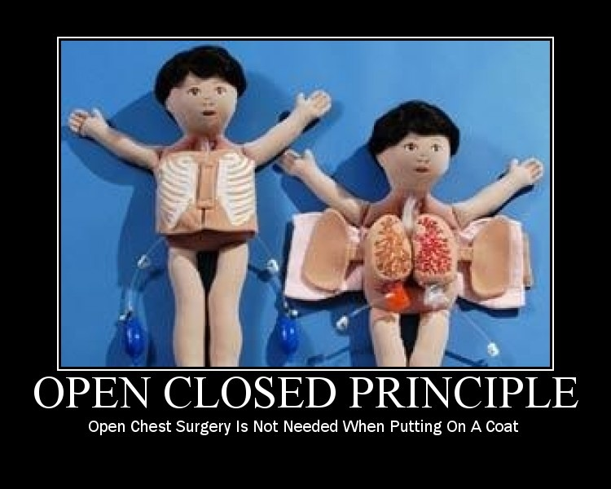

Slide 15
Open-Closed
File Reader
Service
Email Sender
IFile Format Reader
Flat File
XML File
Notes:
Introducing an interface: a generalized role
Implementing the interface for each file type reader.
Allows new file types to be added without changing the format reader service

Slide 16
LSP: Liskov Substitution Principle
Sometimes Semantic Arguments Are Worthwhile
“If for each object o1 of type S there is an object o2 of type T such that for all programs P defined in terms of T, the behavior of P is unchanged when o1 is substituted for o2 then S is a subtype of T.”
- Barbara Liskov

Slide 17
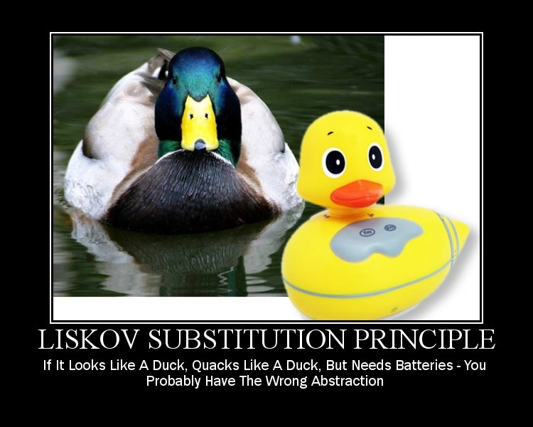

Slide 18
Liskov Substitution
Square
Rectangle
!=

Slide 19
Liskov Substitution
Database
FileReader
Service
Email Sender
IFileFormat Reader
Flat File
XML File
Database Connection File

Slide 20
Liskov Substitution
Database
Database
Reader
Service
Flat File
Email Sender
IFileFormat Reader
FileReader
Service
XML File

Slide 21
ISP: Interface Segregation Principle
Role Specific Interfaces
“Classes that have ‘fat’ interfaces are classes whose interfaces are not cohesive. In other words, the interfaces of the class can be broken up into groups of member functions. Each group serves a different set of clients.”
- Robert Martin

Slide 22
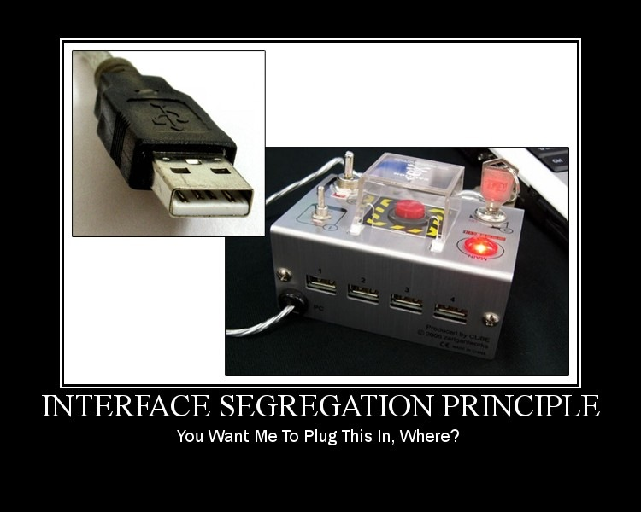

Slide 23
Interface Segregation
EmailSender
EmailSender
Database Reader
Service
SendEmail
ReadFile
ReadFromDb
SendEmail
GetMessageBody
FileReader
Service
GetMessageBody

Slide 24
DIP: Dependency Inversion Principle
Depend On Abstractions, Not Concrete Details And Implementations
“A design is rigid if it cannot be easily changed. Such rigidity is due to the fact that a single change to heavily interdependent software begins a cascade of changes in dependent modules.”
- Robert Martin

Slide 25
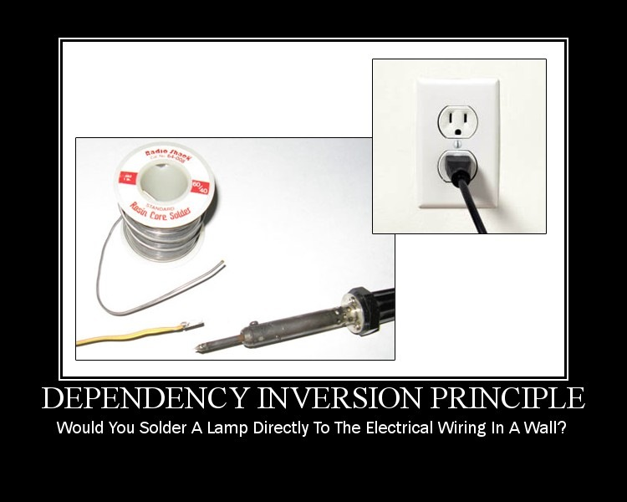

Slide 26
Dependency Inversion
Foo
Bar

Slide 27
Dependency Inversion
Foo
IBar
Bar

Slide 28
Dependency Inversion
Foo
IRoleName
Bar

Slide 29
Dependency Inversion
Xml File Reader
Flat File Reader
IFileFormat Reader
Database Reader Service
File Reader Service
Email Sender
IMessageInfoRetriever
IEmailService
ProcessingService

Slide 30
Summarizing Our S.O.L.I.D. Conversion
Compare And Contrast The Original Code To The New Code

Slide 31
What Did We DO?
IMessageInfo
Retriever
IEmailSender
Email Sending App
EmailProcessingService
Flat File
Database
Database
Reader
Service
IMessage
Info
Retriever
File
XML File
IFileFormat Reader
FileReader
Service
EmailService
IEmail
Service
Before
After

Slide 32
Why? … Coupling
IMessageInfo
Retriever
IEmailSender
EmailProcessingService
Flat File
Database
Database
Reader
Service
IMessage
Info
Retriever
XML File
IFileFormat Reader
FileReader
Service
EmailService
IEmail
Service

Slide 33
Why? … Cohesion
IMessageInfo
Retriever
IEmailSender
EmailProcessingService
Flat File
Database
Database
Reader
Service
IMessage
Info
Retriever
XML File
IFileFormat Reader
FileReader
Service
EmailService
IEmail
Service

Slide 34
Why? … Encapsulation
IMessageInfo
Retriever
IEmailSender
EmailProcessingService
Flat File
Database
Database
Reader
Service
IMessage
Info
Retriever
XML File
IFileFormat Reader
FileReader
Service
EmailService
IEmail
Service

Slide 35
Additional Resources
Uncle Bob’s Principle Of Object Oriented Development:
http://butunclebob.com/ArticleS.UncleBob.PrinciplesOfOod
Pablo’s Topic Of The Month on SOLID, SOLID E-Book, and more
http://lostechies.com
SOLID Software Development in CODE Magazine
http://www.code-magazine.com/article.aspx?quickid=1001061
Agile Principles, Patterns, And Practices In C#
by Robert and Micah Martin, published by Prentice Hall
Derick Bailey - Independent Consultant
Muted Solutions, LLC
WWW:
mutedsolutions.com
derickbailey.lostechies.com
Email:
derick@mutedsolutions.com
derick@derickbailey.com
Twitter:
@derickbailey
Copyright ©2011 Muted Solutions, LLC

